Slide 1

V i s i b i l i t y + California Wildfires
Gabe Jones
Bao Nguyen
Yukari Ide
Oonagh Pretorius

Slide 2
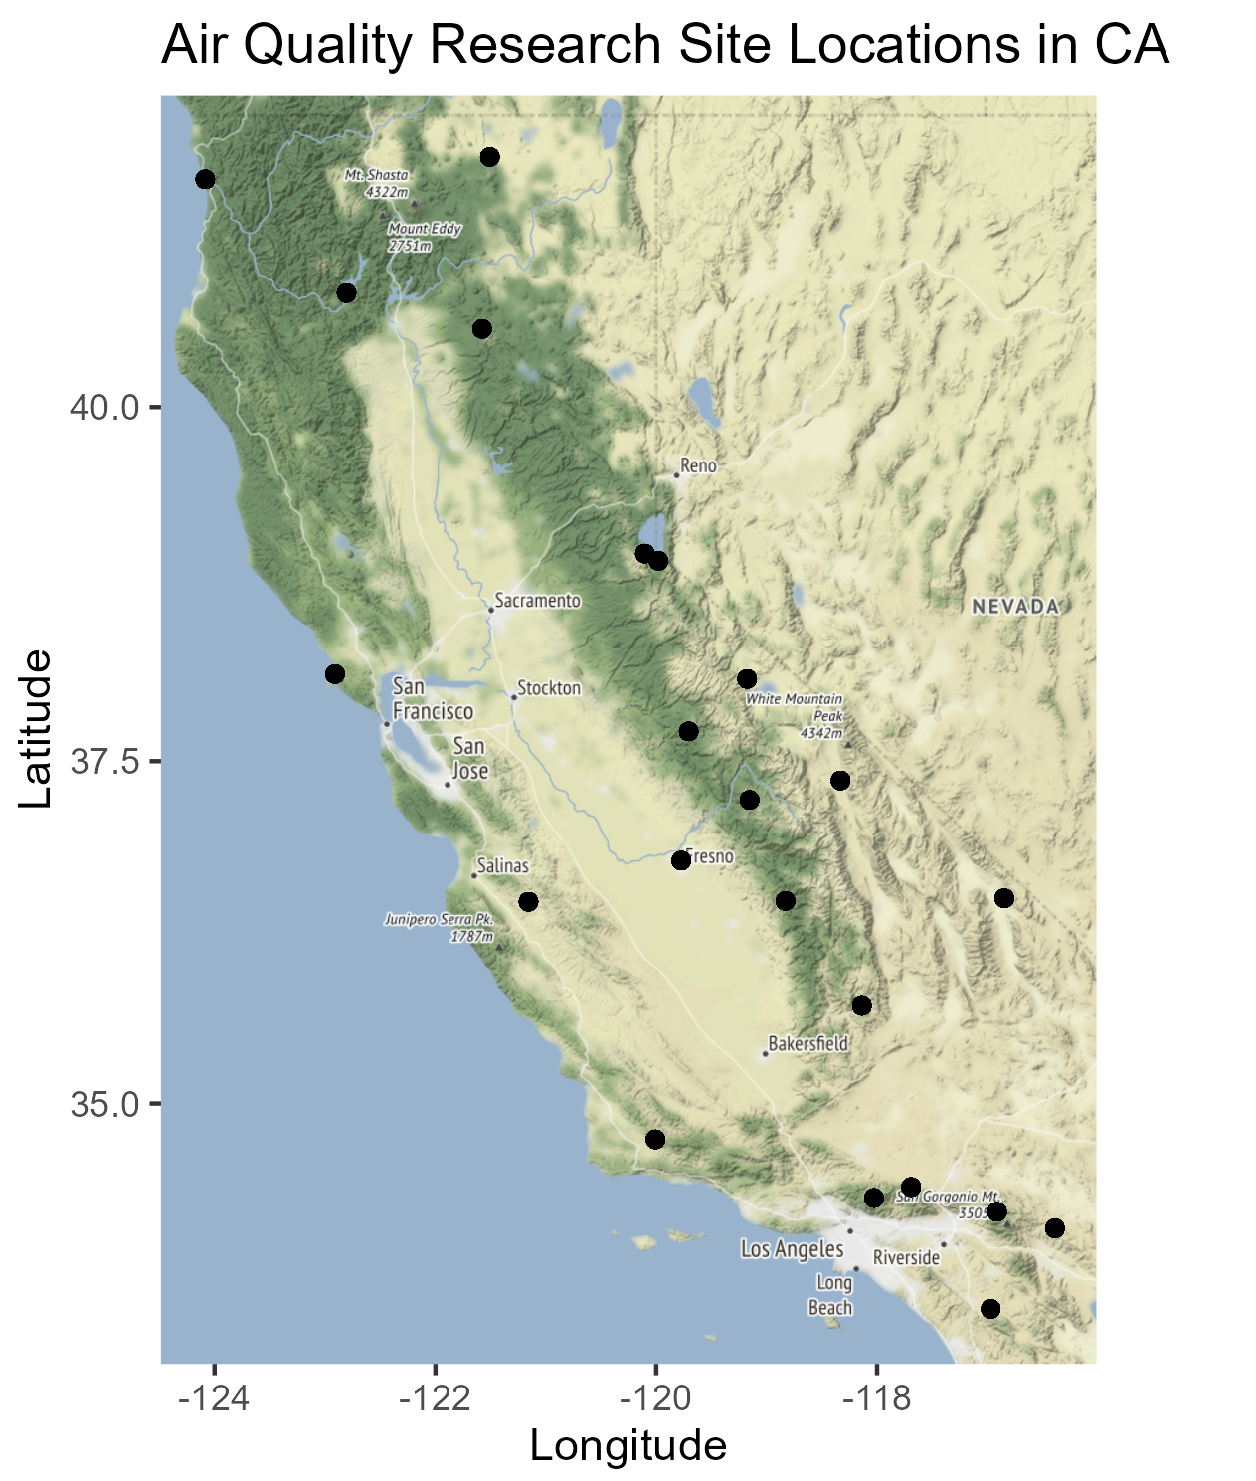
Introduction + Metadata
Interagency Monitoring of Protected Visual Environments program
- UCD Air Quality Research Center & EPA
23 IMPROVE Research Sites in rural CA
Sampling stations collect haze-forming particles
Visibility Conditions
Changes in visibility over time
Sources & causes of haze
Notes:
Haze causes discoloration, loss of texture, and diminished visual range,
Some pollutants that form haze have been linked to seriously detrimental health effects and environmental damage.

Slide 3
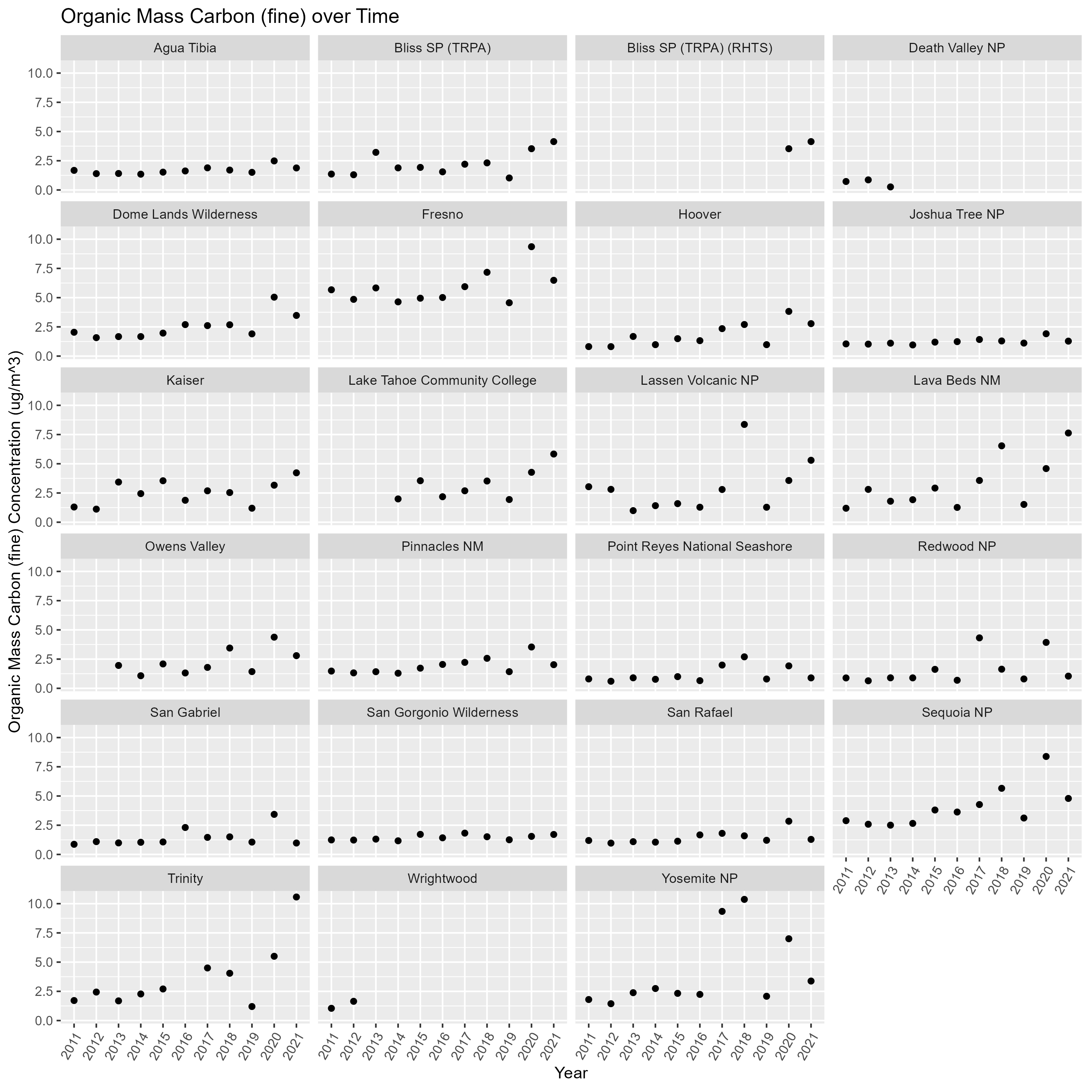
Data + Exploration
Data were mostly tidy
Units in own cells
2011-2021 subset
26 633 entries
6 particulate variables
Evaluated per year and season for each site
Variable | Description | Units
ammNO3f | Ammonium Nitrate (fine) | ug/m^3
ammSO4 | Ammonium Sulfate (fine) | ug/m^3
ECf | Elemental Carbon (fine) | ug/m^3
OMCf | Organic Mass Carbon (fine) | ug/m^3
SOILf | Soil particles (fine) | ug/m^3
SVR | Standard Visual Range | km
Notes:
Visibility is the greatest distance at which an observer can just see a black object viewed against the horizon sky.
Visual Range is the distance at which a large black object just disappears from view.

Slide 4
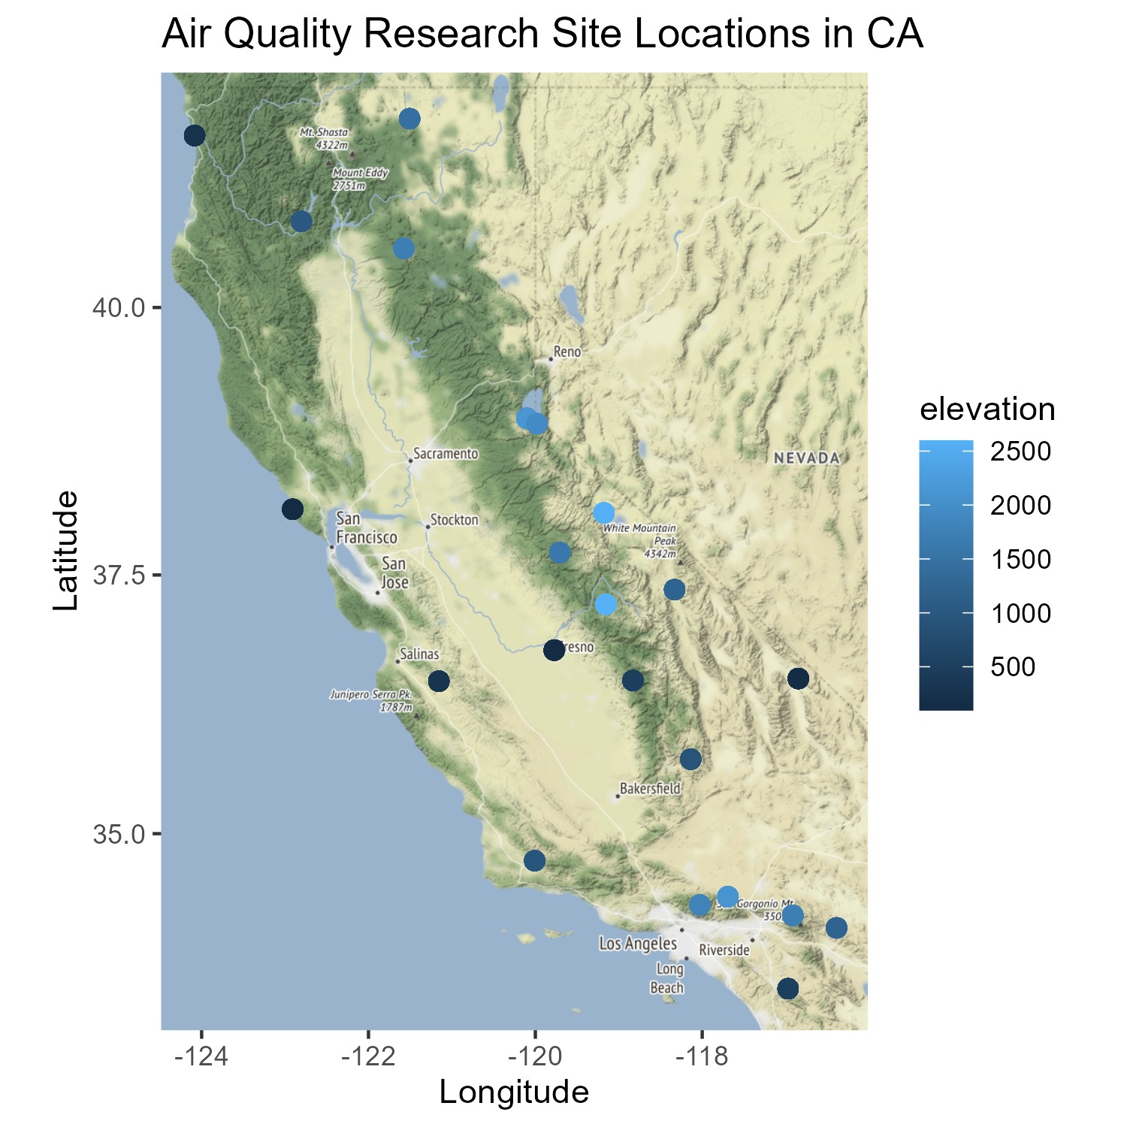
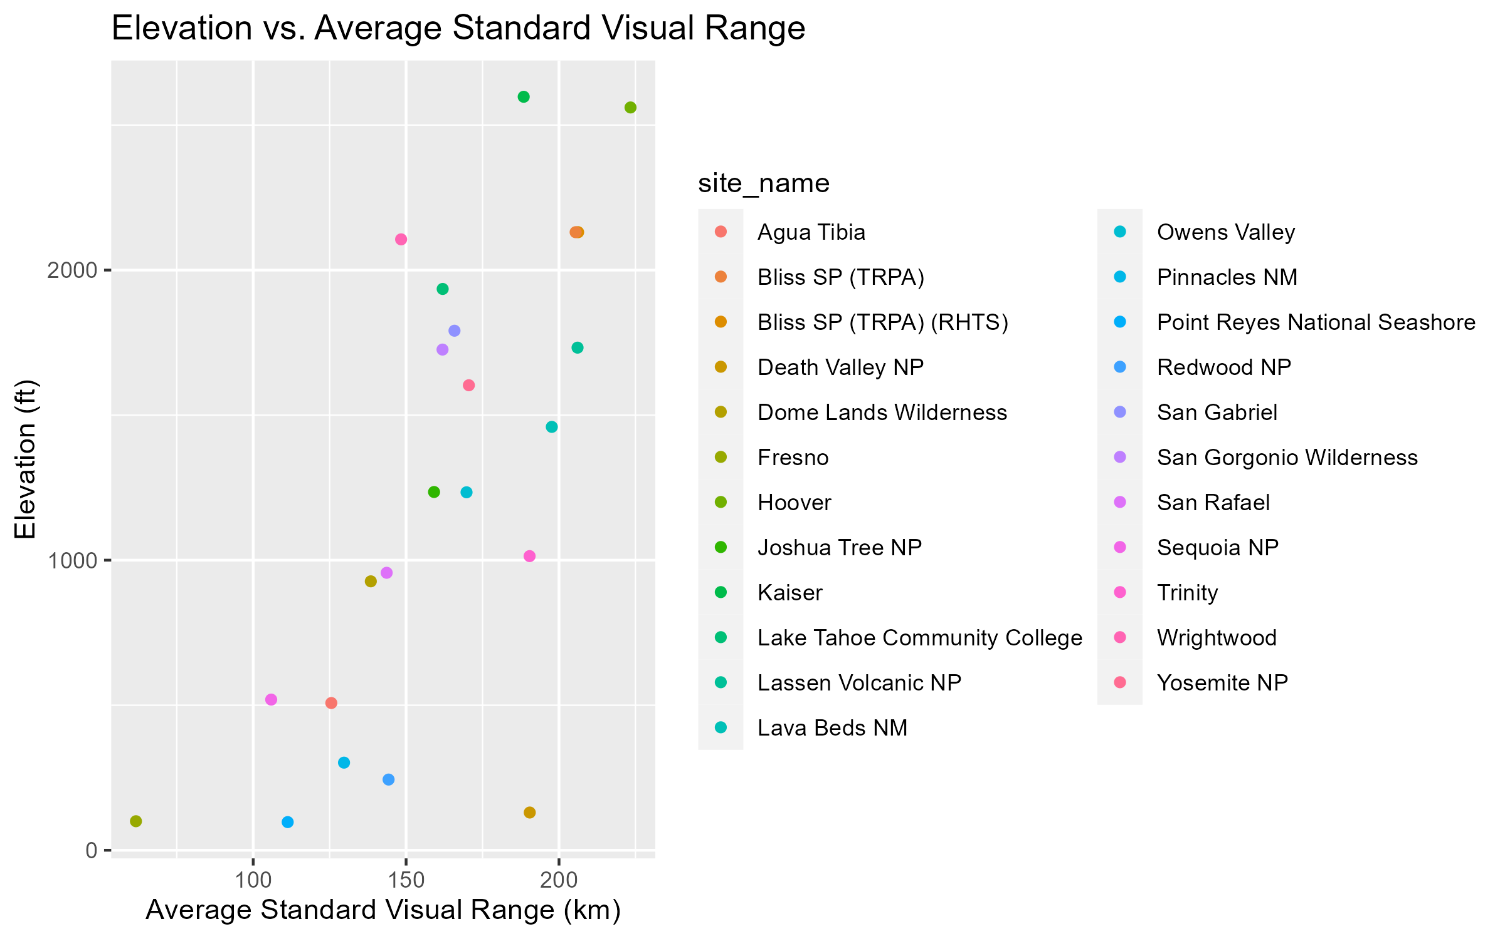
Elevation + Standard Visual Range
Notes:
Generally, the higher the site, the better the visibility. Best SVR = Hoover. Worst SVR = Fresno.

Slide 5
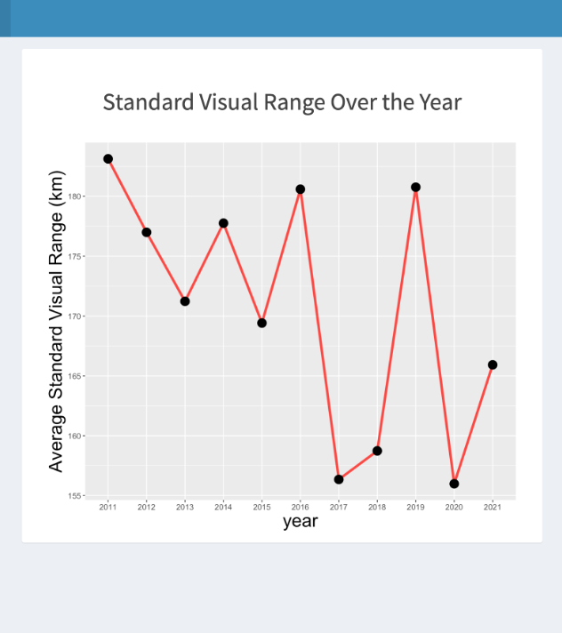
V i s i b i l i t y + Shiny Apps
Visualize average annual SVR by site
Points represent SVR in that year
Lower visual range = [particulate matter]

Slide 6
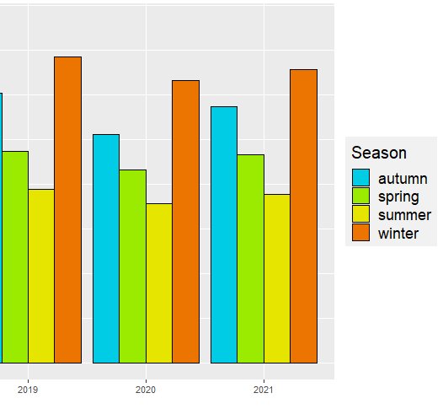
Seasonal Metrics + Trends
This app allows us to:
Observe seasonal patterns of different metrics historically over the past 10 years
Compare these trends and forecast potential SVR changes during certain seasons or environmental events
- Risk assessment for pilots
Link changes in SVR to different visibility metrics for each season
- Which particles have the biggest impact?

Slide 7
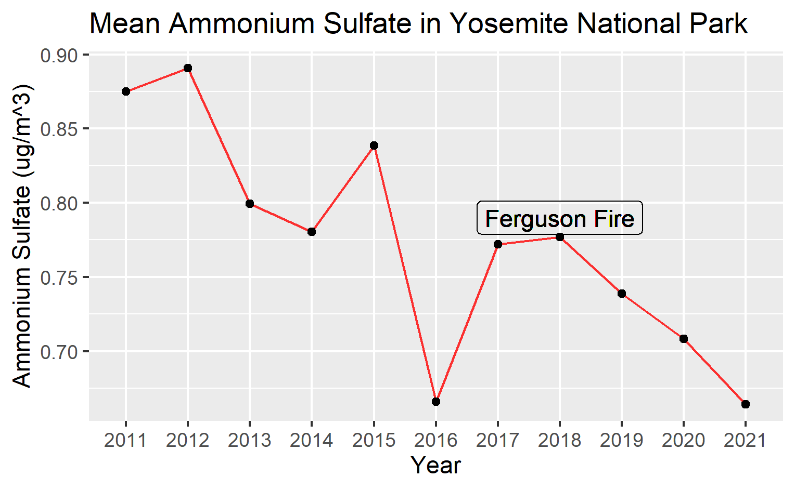
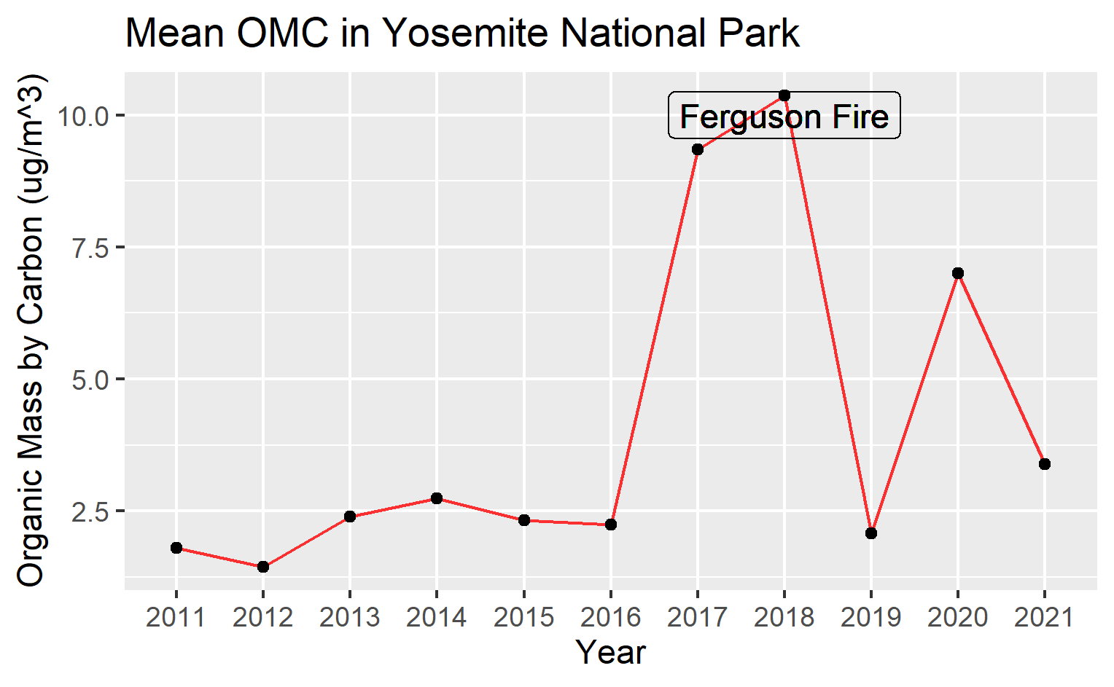
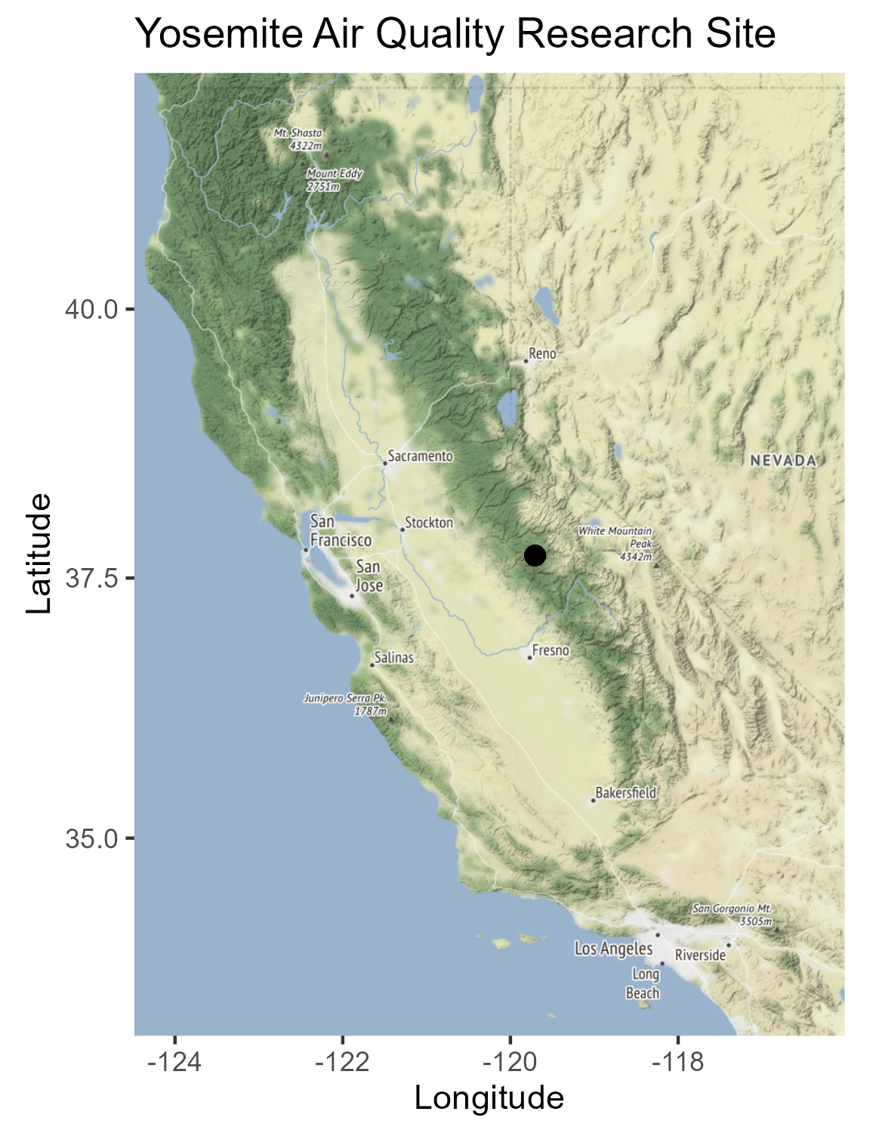
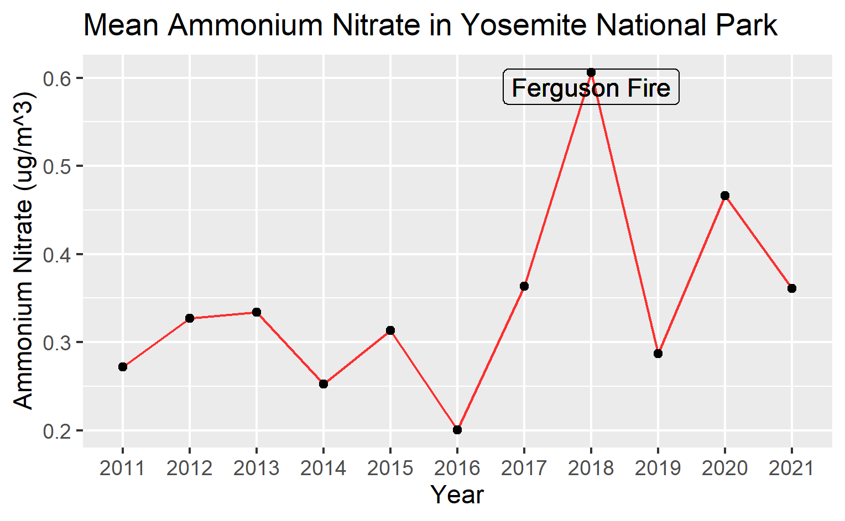
Interpretation + Yosemite NP
FERGUSON FIRE 2018
13 July → 19 August
96,901 acres burned
Also affected Stanislaus & Sierra National Forests
Notes:
Hello test test

Slide 8
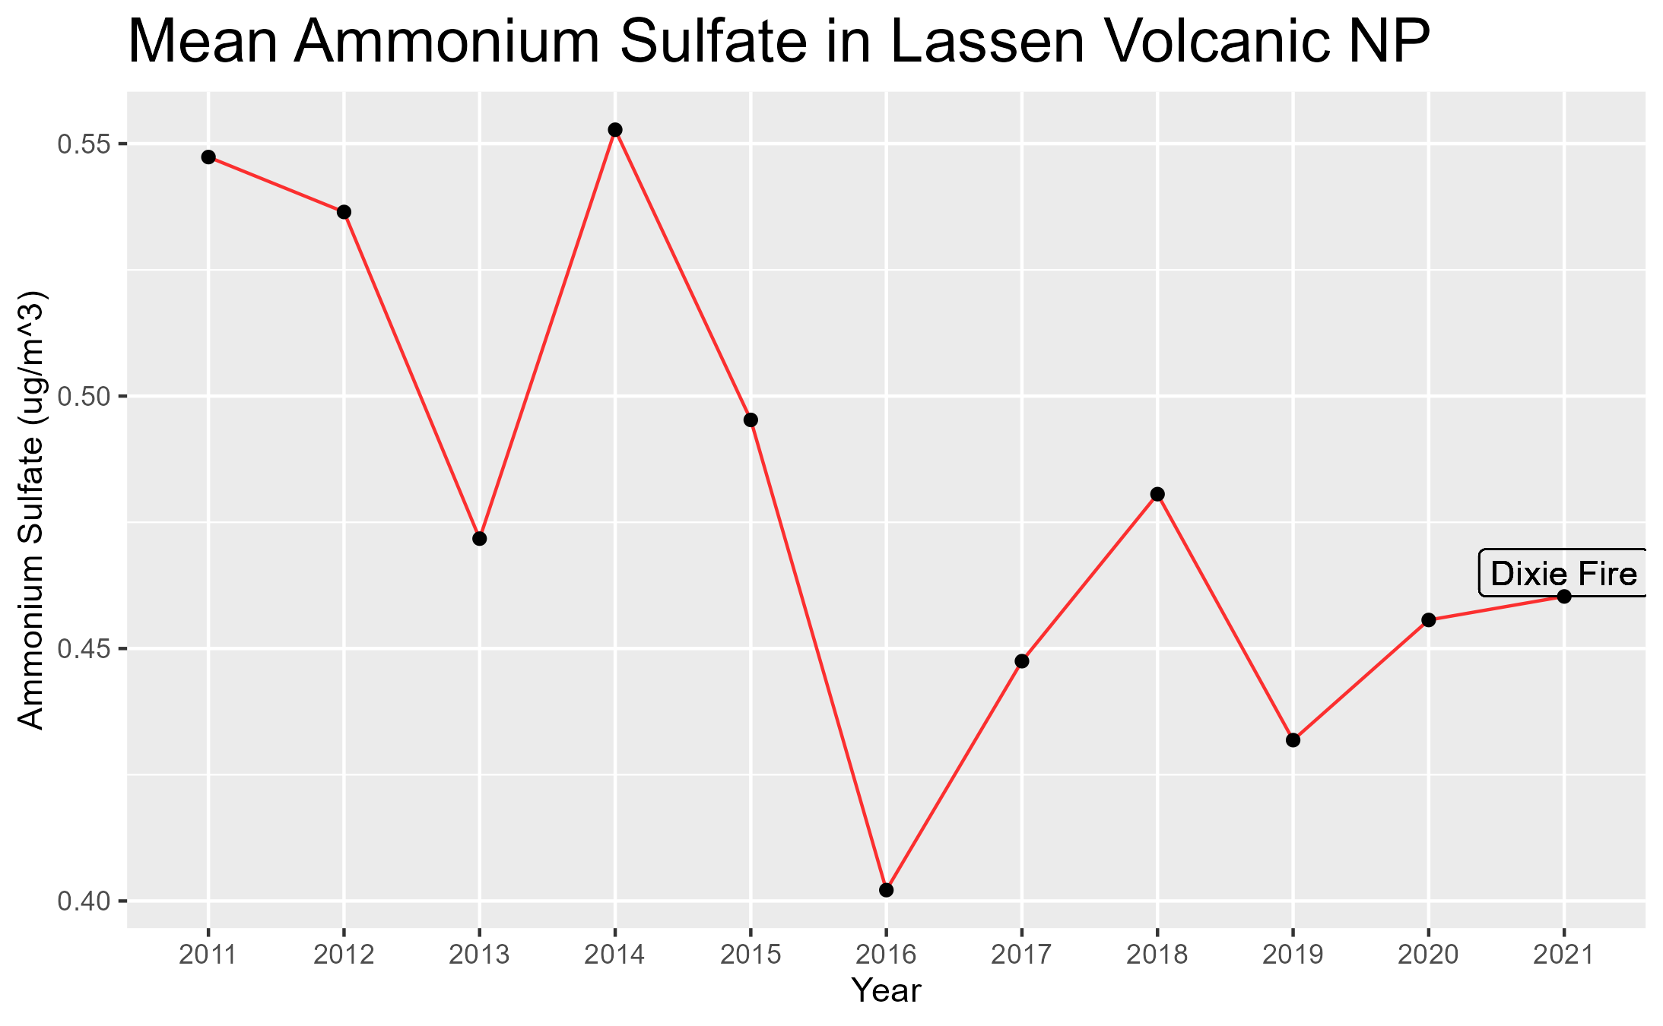
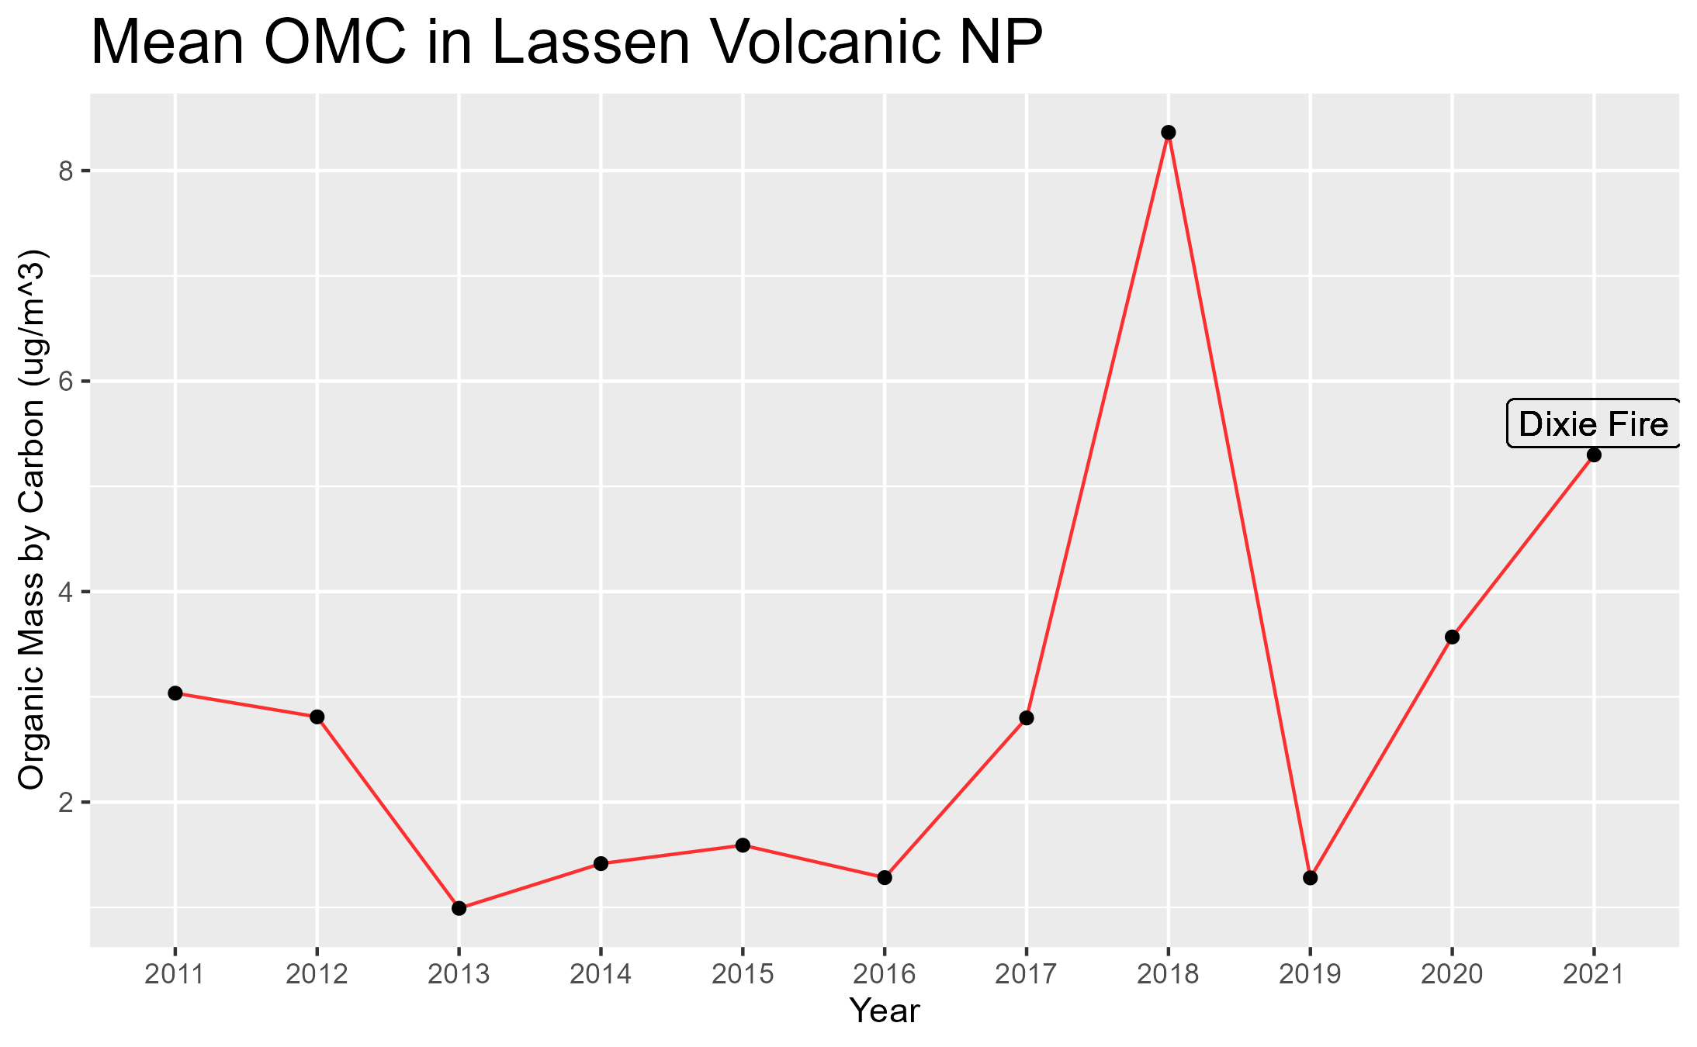
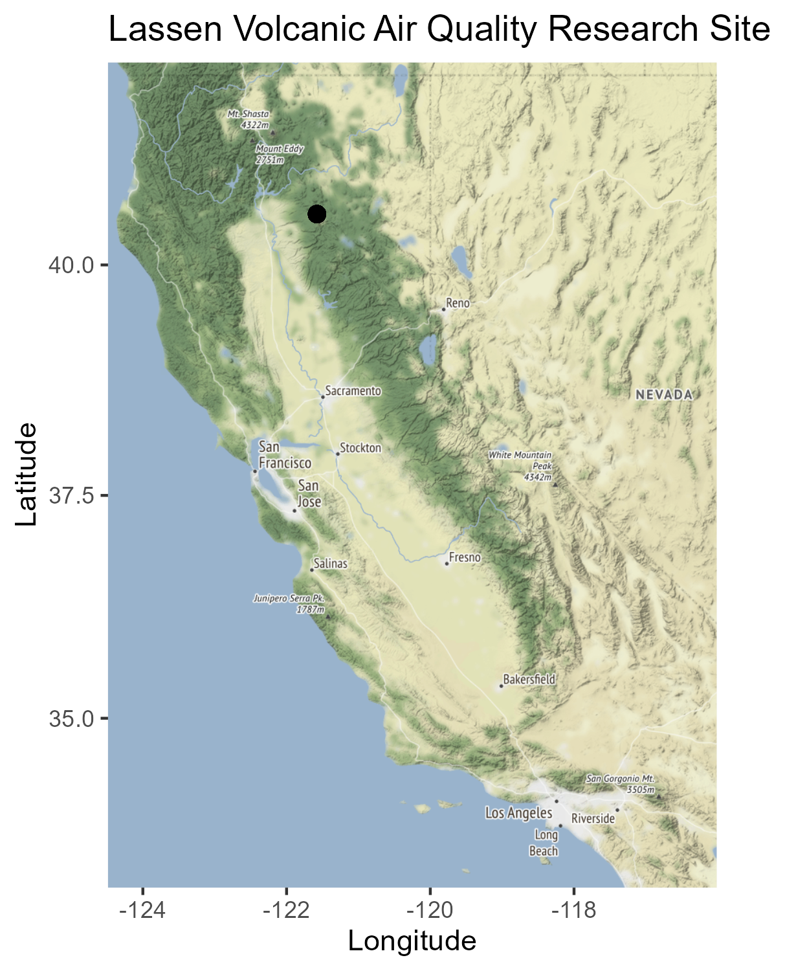
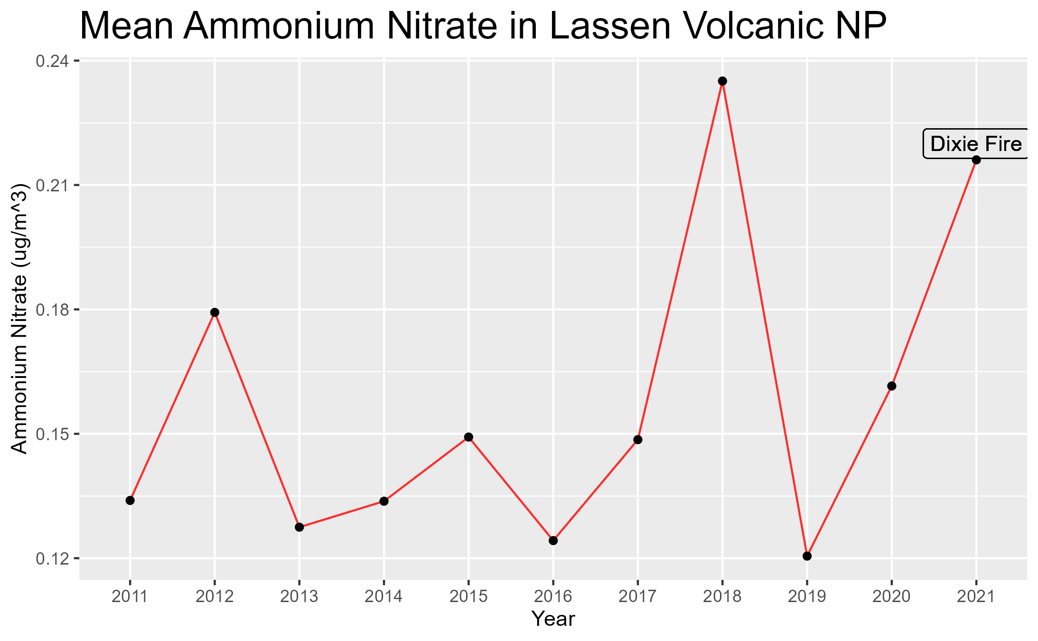
Interpretation + Lassen Volcanic NP
DIXIE FIRE 2021
13 July → 25 October
963,309 acres burned
Largest wildfire recorded in California

Slide 9
Conclusion + recommendations
Expand the analysis to all sites and variables in the dataset
Develop Air Quality Index App for the general public
Utilize trends in atmospheric readings to inform policy and identify targeted areas for environmental intervention
Track environmental pollutant levels using visibility monitoring systems
Explored how these metrics correlate to occurrences of California wildfires

